Slide 1
Maelstrom: Are you playing with a full deck?
Using an Attack Lifecycle Game to Educate, Demonstrate and Evangelize
Shane Steiger, Esq. CISSP
DEF CON 24
#cybermaelstrom
Shane Steiger © 2016
github.com/maelstromthegame/defcon24

Slide 2
$ whoami
messing with computers since 1989 - TIN, PINE, yTalk, Lynx, MUDs, etc.
8 years in a large food manufacturer helping to build and secure SCADA/ICS systems across 90+ food manufacturing plants in the US.
6 years building out a security function in one of the largest pharmaceutical drug distributors in the US.
currently Chief Endpoint Security Architect in a large tech company building out the roadmaps for desirable Cyber Resiliency techniques in the endpoint space.
much better than family law! I am more of a geek.

Slide 3
$ disclaimer
the views and opinions are purely my own based on time in the industry and experience. They don’t necessarily reflect the views, positions or policies of my employer.
oh yeah....this presentation and discussion is not intended to give legal advice nor form any kind of attorney/client relationship. I am not your attorney and some of the things you might find interesting may require consultation with your own attorney (not me ☺).

Slide 4
$ agenda
unexpected journey to a cyber attack lifecycle game
research that took me on that journey
maelstrom the game

Slide 5
$ strategy journey
from a past life, I was asked by a CIO ‘do they win?’
later, asked to look at a solution for over 300k endpoints
like most folks – look at requirements, functionality, capabilities and operationalization
hmmmm....wow I got a pretty heat map that doesn’t seem very useful in terms of selecting things at large scale
‘do they win’ stuck with me; find a way to develop better strategic choices

Slide 6
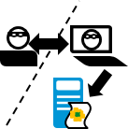

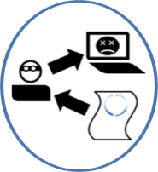
$ Lockheed Martin Cyber Kill Chain ®
Reconnaissance
Exploitation
Delivery
Installation
Command and Control
Research, ID/selection of targets
Weaponization
Email addresses
Social relationships
Target technology & topology
Combining an exploit with a payload to establish/maintain access by attacker
Transmission of weapon to target environment
Exploit is triggered on target
Payload is executed
Communication and control is established between attacker and target
Act on Objectives
Recon/Pivot
Destruction
Exfiltration
http://www.lockheedmartin.com/content/dam/lockheed/data/corporate/documents/LM-White-Paper-Intel-Driven-Defense.pdf

Slide 7
$ Lockheed Martin Cyber Kill Chain ®
Reconnaissance
Exploitation
Delivery
Installation
Command and Control
Research, ID/selection of targets
Weaponization
Email addresses
Social relationships
Target technology & topology
Combining an exploit with a payload to establish/maintain access by attacker
Transmission of weapon to target environment
Exploit is triggered on target
Payload is executed
Communication and control is established between attacker and target
Act on Objectives
Recon/Pivot
Destruction
Specific public-use email aliases for key personnel, tied to increased inspection/intel
Program to ensure anti-malware solutions are able to detect commodity exploit framework dropper
Robust email content inspection and attachment anti-malware, leveraging actionable intel
Robust host-anti malware/HIPS
Containerization,
limited use of Java, Adobe Reader & Flash
Robust host anti-malware/HIPS
Robust proxy/cloud http anti-malware & content inspect with SSL decrypt
Robust proxy/cloud http anti-malware & content inspection
IR process leverage HIPS & network access control from netflow
Robust proxy/cloud content inspect with SSL decrypt and actionable intel
Robust host or network DLP with policy appropriate for development system
Exfiltration
http://www.lockheedmartin.com/content/dam/lockheed/data/corporate/documents/LM-White-Paper-Intel-Driven-Defense.pdf

Slide 8

$ Lockheed Martin Cyber Kill Chain®*misnomer
Act on Objectives
Reconnaissance
Exploitation
Delivery
Installation
Command and Control
Research, ID/selection of targets
Weaponization
Email addresses
Social relationships
Target technology & topology
Combining an exploit with a payload to establish/maintain access by attacker
Transmission of weapon to target environment
Exploit is triggered on target
Payload is executed
Communication and control is established between attacker and target
Exfiltration
DoS
PlantInfo
Humiliate
Recon/Pivot
*defender is the actor in a kill chain!
Ransomware
Destruction
http://www.lockheedmartin.com/content/dam/lockheed/data/corporate/documents/LM-White-Paper-Intel-Driven-Defense.pdf

Slide 9
$ charting attacker’s progression
What does this look like?
Recon
Weaponization
Delivery
Exploit
Install
C&C
Act on Objective
Attack Execution Over Time

Slide 10
$ charting attacker’s plan
looks like a Gantt Chart! A project plan!
Attackers are organized indicating plan progression for campaigns
what other evidence have we seen to indicate the attackers seem to follow a plan if not a traditional project plan?
Different skill levels from the same attackers indicating different ’resources or teams’
Different teams using different tool sets
Different time schedules indicating 'shift work’
Follow scripts and make mistakes redoing work or retrying task

Slide 11
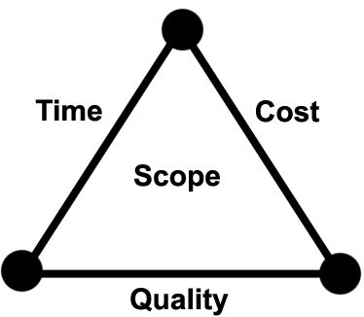
$ tortuosa concept – attacking attacker’s plan
what can defenders do? attack the project plan!!!
IT organizations are experts at messing up project plans! They do it like it is there job! They even have a methodology!!!
Mapping these plans can reveal weakness in the attackers’ plan.
https://en.wikipedia.org/wiki/Project_management_triangle

Slide 12
$ tortuosa concept – attacking attacker’s plan
what techniques can disrupt the attacker’s project plan?
Time: Strategies to attack – ‘assumed linear time’
Replays – only accept replayed web sessions with an additional token
Snapshots – use virtualized environments; revert unpredictably
Predecessors and Successors – feigning completion
Resources and Tools: Attack the ‘tools or shift work’
Create resource unavailability – APT Team F uses Cloudflare; during Team F stage block Cloudflare thereby forcing Team F to page out find another team or resource
Create resource contention – flood your own machines; sacrificial lambs
Different teams using different tool sets – remove PSEXEC, WMI, PowerShell; your management tools that are used against you
Scope: Create scope creep utilizing deception with fake targets or tarpits
Cost: Increase costs by setting the attacker back in progression increases cost to them thereby decreasing cost to defender to remediate
Quality: Create noise and anomalies – attackers, automation and scripts are disrupted

Slide 13
$ tortuosa concept – attacking attacker’s plan
Persistence Disruption
Recon
Weaponization
Delivery
Exploit
Install
C&C
Act on Objective
Attack Execution Over Time

Slide 14
$ tortuosa concept – attacking attacker’s plan
Tool Unavailability
Recon
Weaponization
Delivery
Exploit
Install
C&C
Act on Objective
Attack Execution Over Time

Slide 15
$ tortuosa concept – attacking attacker’s plan
Orchestrated False Targets
Recon
Weaponization
Delivery
Exploit
Install
C&C
Act on Objective
Attack Execution Over Time

Slide 16
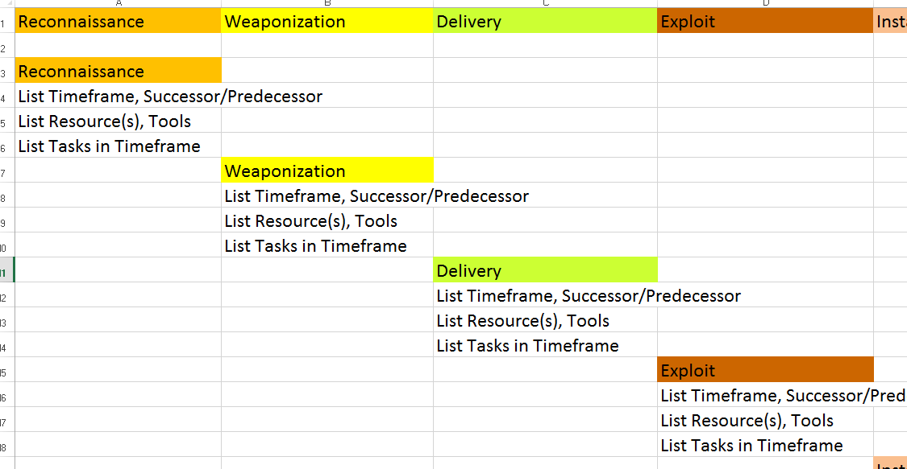
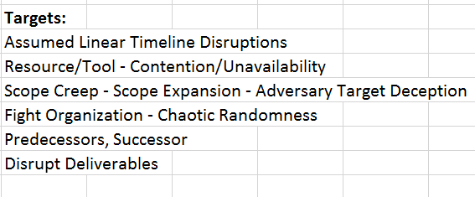
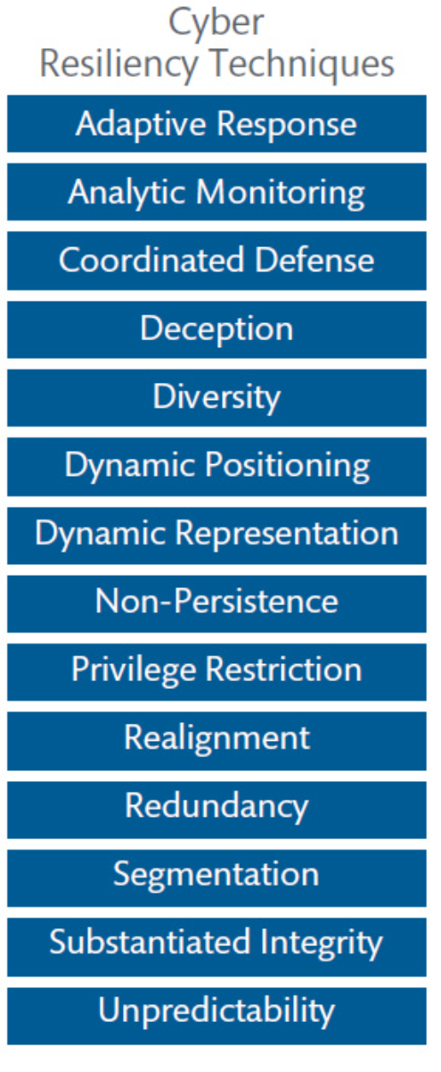
$ tortuosa concept – attacking attacker’s plan
***https://www.mitre.org/publications/technical-papers/cyber-resiliency-engineering-framework

Slide 17
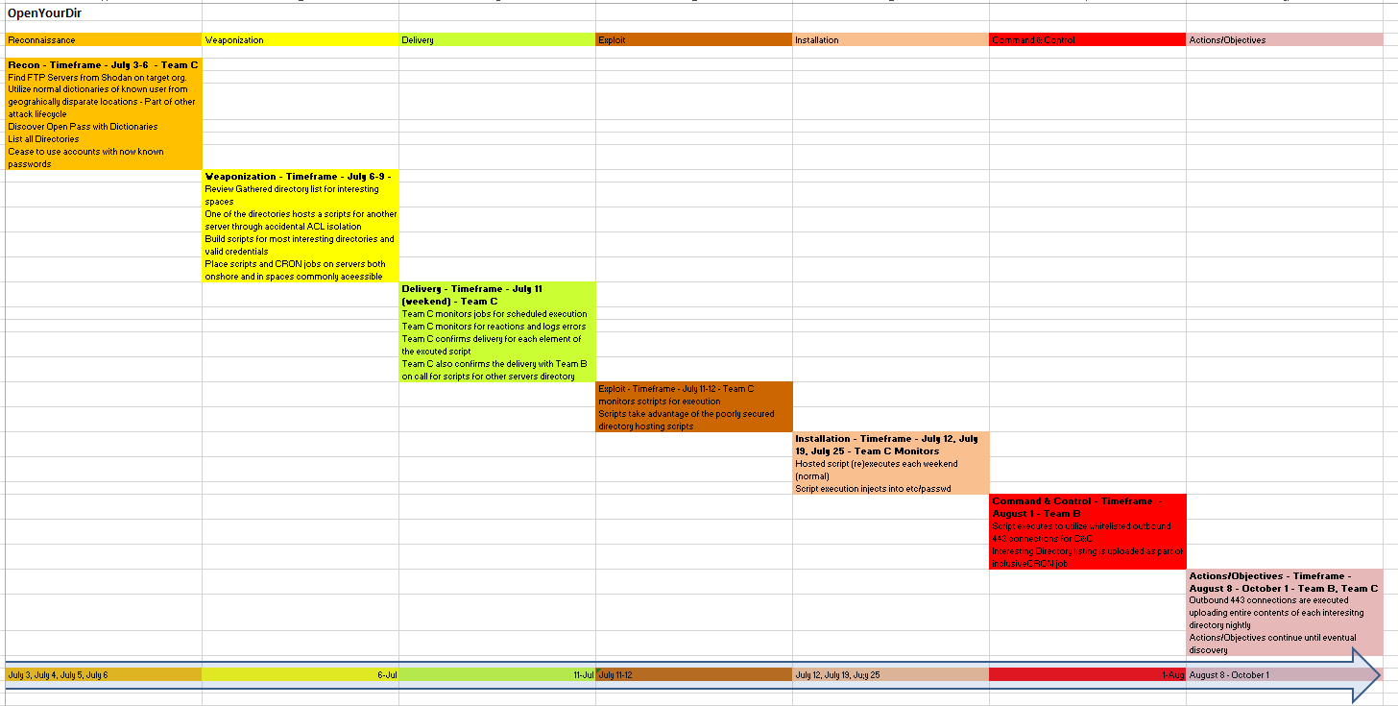
$ tortuosa concept – attacking attacker’s plan
Mapped: Axiom, Cleaver, Dark Hotel, FIN4, 02Hero, SAPU4ALL, StuckOnUrDC, OpenYourDir

Slide 18
$ let’s build a catalog of attack patterns
Recon
Port Scans
Weaponize
Custom Toolset/0-day exploit
Criminal Commodity Framework
Delivery
RCE on internet facing host
Malicious email attachment
Google/Shodan Search
Exploit
Buffer Overflow
Install
(Destruction) drive of controlled host is wiped
Initial exploit modifies existing service/code
A/O
SSL connection over arbitrary port
C&C
Exploratory Phishing Attacks
Metasploit Module/PoC toolset
Malicious URL
Malicious leverage of user’s rights
Privilege Escalation
Installation of new backdoor via inline-code
HTTP/HTTPS posts back to attacker C&C host
Data xfer via DNS query
Executed dropper pulls rootkit code
(Pivot & Recon) controlled host used to scan for open fileshares
(Exfiltration) documents found on controlled host are sent back to attacker

Slide 19
$ let’s build a catalog of attack patterns
Recon
Port Scans
Weaponize
Custom Toolset/0-day exploit
Criminal Commodity Framework
Delivery
RCE on internet facing host
Malicious email attachment
Google/Shodan Search
Exploit
Buffer Overflow
Install
(Destruction) drive of controlled host is wiped
Initial exploit modifies existing service/code
A/O
SSL connection over arbitrary port
C&C
Exploratory Phishing Attacks
Metasploit Module/PoC toolset
Malicious URL
Malicious leverage of user’s rights
Privilege Escalation
Installation of new backdoor via inline-code
HTTP/HTTPS posts back to attacker C&C host
Data xfer via DNS query
Executed dropper pulls rootkit code
(Pivot & Recon) controlled host used to scan for open fileshares
(Exfiltration) documents found on controlled host are sent back to attacker

Slide 20

$ research based attack catalog techniques
MITRE’s CAPEC (Common Attack Patterns and Enumeration Catalogue)
500+ techniques
Slightly unmanageable for my needs
MITRE’s ATT&CK Framework (Adversarial Tactics, Techniques & Common Knowledge)
68 techniques!
More manageable
Attack lifecycle map
Win!

Slide 21
$ building the attacker deck
Build catalog of attack patterns – MITRE ATT&CK Framework – 8/2015***
Persistence | Privilege Escalation | Credential Access | Host Enumeration | Defense Evasion | Lateral Movement | Command and Control | Exfiltration
New service | Exploitation of vulnerability | OS/Software Weakness | Process enumeration | Software packing | RDP | Common protocol, follows standard | Normal C&C channel
Modify existing service | Service file permissions weakness | User interaction | Service enumeration | Masquerading | Windows admin shares (C$, ADMIN$) | Common protocol, non-standard | Alternate data channel
DLL Proxying | Service registry permissions weakness | Network sniffing | Local network config | DLL Injection | Windows shared webroot | Commonly used protocol on non-standard port | Exfiltration over other network medium
Hypervisor Rookit | DLL path hijacking | Stored file | Local network connections | DLL loading | Remote vulnerability | Communications encrypted | Exfiltration over physical medium
Winlogon Helper DLL | Path interception |  | Window enumeration | Standard protocols | Logon scripts | Communications are obfuscated | Encrypted separately
Path Interception | Modification of shortcuts |  | Account enumeration | Obfuscated payload | Application deployment software | Distributed communications | Compressed separately
Registry run keys / Startup folder addition | Editing of default handlers |  | Group enumeration | Indicator removal | Taint shared content | Multiple protocols combined | Data staged
Modification of shortcuts | AT / Schtasks / Cron |  | Owner/user enumeration | Indicator blocking | Access to remote services with valid credentials |  | Automated or scripted data exfiltration
MBR / BIOS rootkit |  |  | Operating system enumeration |  | Pass the hash |  | Size limits
Editing of default handlers |  |  | Security software enumeration |  |  |  | Scheduled transfer
AT / Schtasks / Cron |  |  | File system enumeration
***https://attack.mitre.org/wiki/Main_Page - 8-2015

Slide 22
$ building the attacker deck
Build catalog of attack patterns – MITRE ATT&CK Framework – 8/2015***
Persistence | Privilege Escalation | Credential Access | Host Enumeration | Defense Evasion | Lateral Movement | Command and Control | Exfiltration
New service | Exploitation of vulnerability | OS/Software Weakness | Process enumeration | Software packing | RDP | Common protocol, follows standard | Normal C&C channel
Modify existing service | Service file permissions weakness | User interaction | Service enumeration | Masquerading | Windows admin shares (C$, ADMIN$) | Common protocol, non-standard | Alternate data channel
DLL Proxying | Service registry permissions weakness | Network sniffing | Local network config | DLL Injection | Windows shared webroot | Commonly used protocol on non-standard port | Exfiltration over other network medium
Hypervisor Rookit | DLL path hijacking | Stored file | Local network connections | DLL loading | Remote vulnerability | Communications encrypted | Exfiltration over physical medium
Winlogon Helper DLL | Path interception |  | Window enumeration | Standard protocols | Logon scripts | Communications are obfuscated | Encrypted separately
Path Interception | Modification of shortcuts |  | Account enumeration | Obfuscated payload | Application deployment software | Distributed communications | Compressed separately
Registry run keys / Startup folder addition | Editing of default handlers |  | Group enumeration | Indicator removal | Taint shared content | Multiple protocols combined | Data staged
Modification of shortcuts | AT / Schtasks / Cron |  | Owner/user enumeration | Indicator blocking | Access to remote services with valid credentials |  | Automated or scripted data exfiltration
MBR / BIOS rootkit |  |  | Operating system enumeration |  | Pass the hash |  | Size limits
Editing of default handlers |  |  | Security software enumeration |  |  |  | Scheduled transfer
AT / Schtasks / Cron |  |  | File system enumeration
***https://attack.mitre.org/wiki/Main_Page - 8-2015

Slide 23
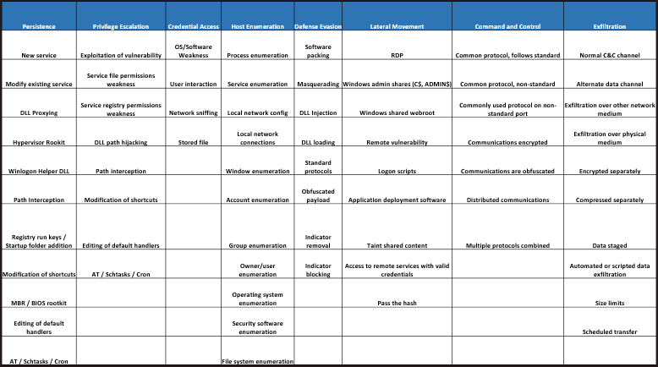
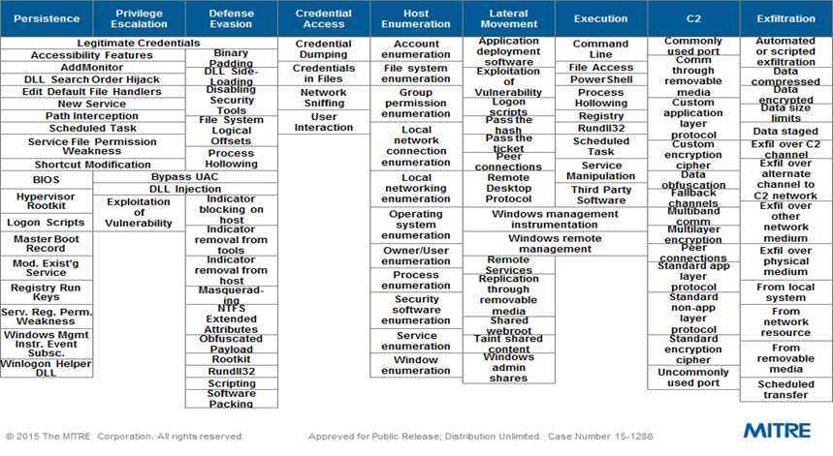
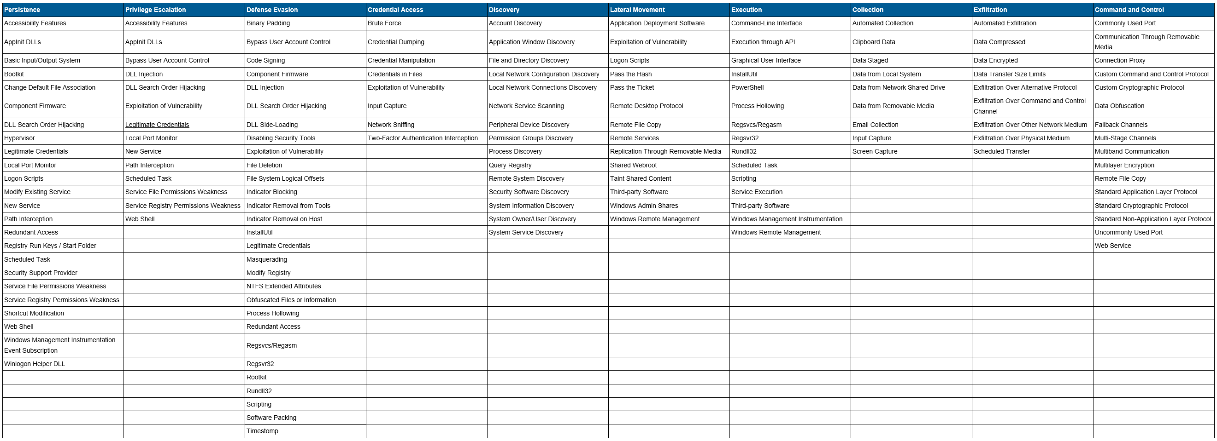
$ building the attacker deck
Build catalog of attack patterns – Updated 7/28/2016 ***
2/2015
10/2015
7/28/2016
***https://attack.mitre.org/wiki/Main_Page - 1-2015, 10-2015, 7/28/2016

Slide 24
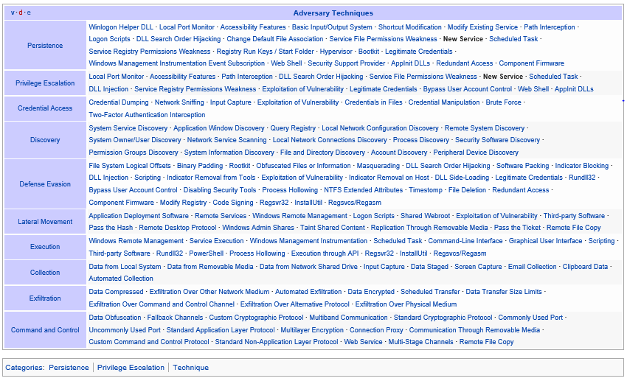
$ building the attacker deck
Build catalog of attack patterns – MITRE ATT&CK Framework – 8/2015***
***https://attack.mitre.org/wiki/Main_Page - 8-2015

Slide 25
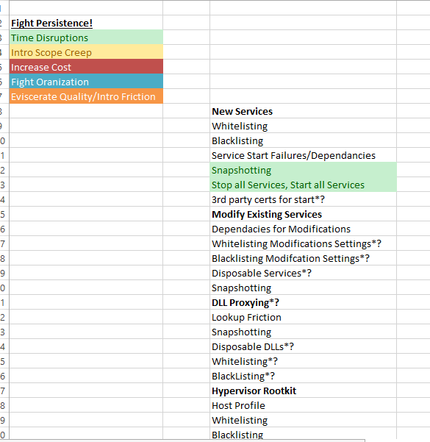
$ building the defender deck
Defensive Strategies to Each ATT&CK Technique – Complimentary Cards
Persistence | Privilege Escalation | Credential Access | Host Enumeration | Defense Evasion | Lateral Movement | Command and Control | Exfiltration
New service | Exploitation of vulnerability | OS/Software Weakness | Process enumeration | Software packing | RDP | Common protocol, follows standard | Normal C&C channel
Modify existing service | Service file permissions weakness | User interaction | Service enumeration | Masquerading | Windows admin shares (C$, ADMIN$) | Common protocol, non-standard | Alternate data channel
DLL Proxying | Service registry permissions weakness | Network sniffing | Local network config | DLL Injection | Windows shared webroot | Commonly used protocol on non-standard port | Exfiltration over other network medium
Hypervisor Rookit | DLL path hijacking | Stored file | Local network connections | DLL loading | Remote vulnerability | Communications encrypted | Exfiltration over physical medium
Winlogon Helper DLL | Path interception |  | Window enumeration | Standard protocols | Logon scripts | Communications are obfuscated | Encrypted separately
Path Interception | Modification of shortcuts |  | Account enumeration | Obfuscated payload | Application deployment software | Distributed communications | Compressed separately
Registry run keys / Startup folder addition | Editing of default handlers |  | Group enumeration | Indicator removal | Taint shared content | Multiple protocols combined | Data staged
Modification of shortcuts | AT / Schtasks / Cron |  | Owner/user enumeration | Indicator blocking | Access to remote services with valid credentials |  | Automated or scripted data exfiltration
MBR / BIOS rootkit |  |  | Operating system enumeration |  | Pass the hash |  | Size limits
Editing of default handlers |  |  | Security software enumeration |  |  |  | Scheduled transfer
AT / Schtasks / Cron |  |  | File system enumeration
***https://attack.mitre.org/wiki/Main_Page - 8-2015

Slide 26
$ tortuosa concept – attacking attacker’s plan
While mapping noticed something….
Some defensive techniques appear most often – Invest!!!!
Progression disruption – Time
Build anomalies and fake targets with trips – Scope Creep
Deception of phase exit – Predecessor/Successor
Some strategies seem to have little payoff but high investment
Don’t bang head here!!!!
This made sense! Spending time buried in Cyber Resiliency Engineering Framework – This validated the findings.
https://www.mitre.org/publications/technical-papers/cyber-resiliency-engineering-framework
http://www2.mitre.org/public/industry-perspective/

Slide 27
$ tortuosa concept – attacking attacker’s plan
Noticed something more…
Got an Attacker Deck
Got a Defender Deck
Got a Progressive Board
…maybe a game?

Slide 28
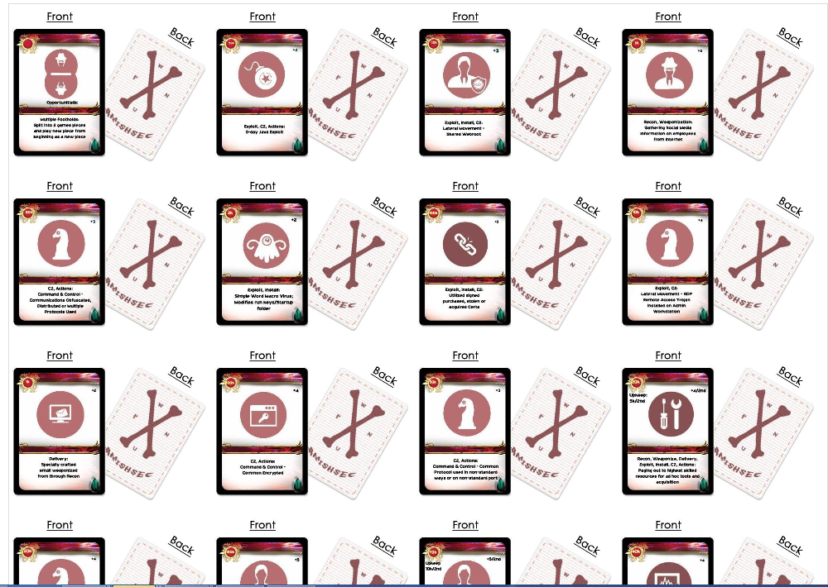
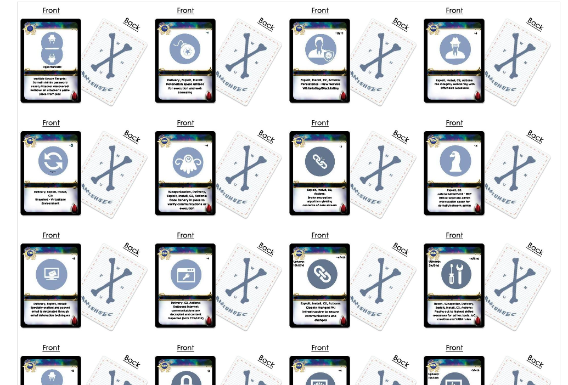
$ maelstrom – are you playing with a full deck?
Game Mock Up – Attacker Red Deck – Defender Blue Deck

Slide 29
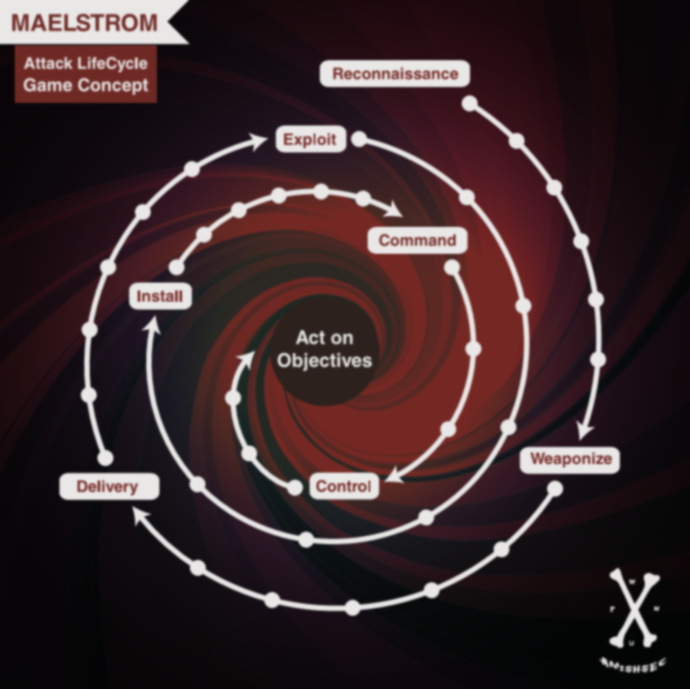
$ maelstrom – are you playing with a full deck?
Game Board – Give and take between attacker and defender

Slide 30
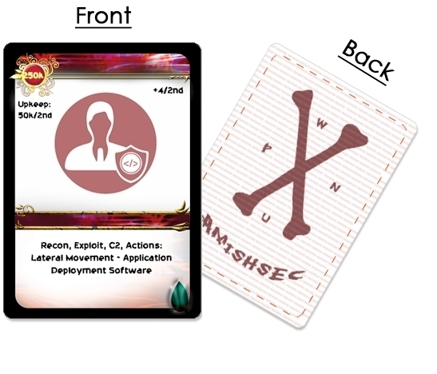
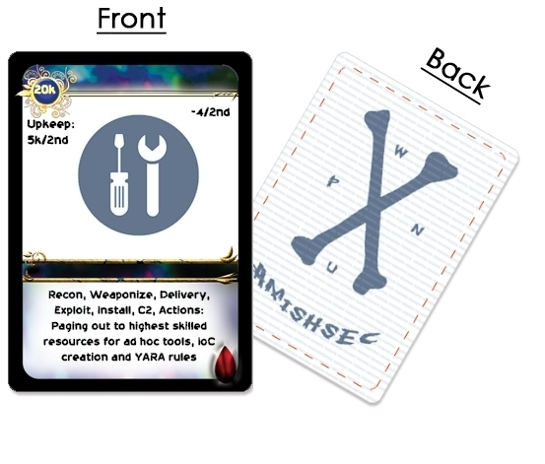
Card Anatomy – Progression, Cost, Upkeep, Usage – Build a Story
$ maelstrom – are you playing with a full deck?

Slide 31
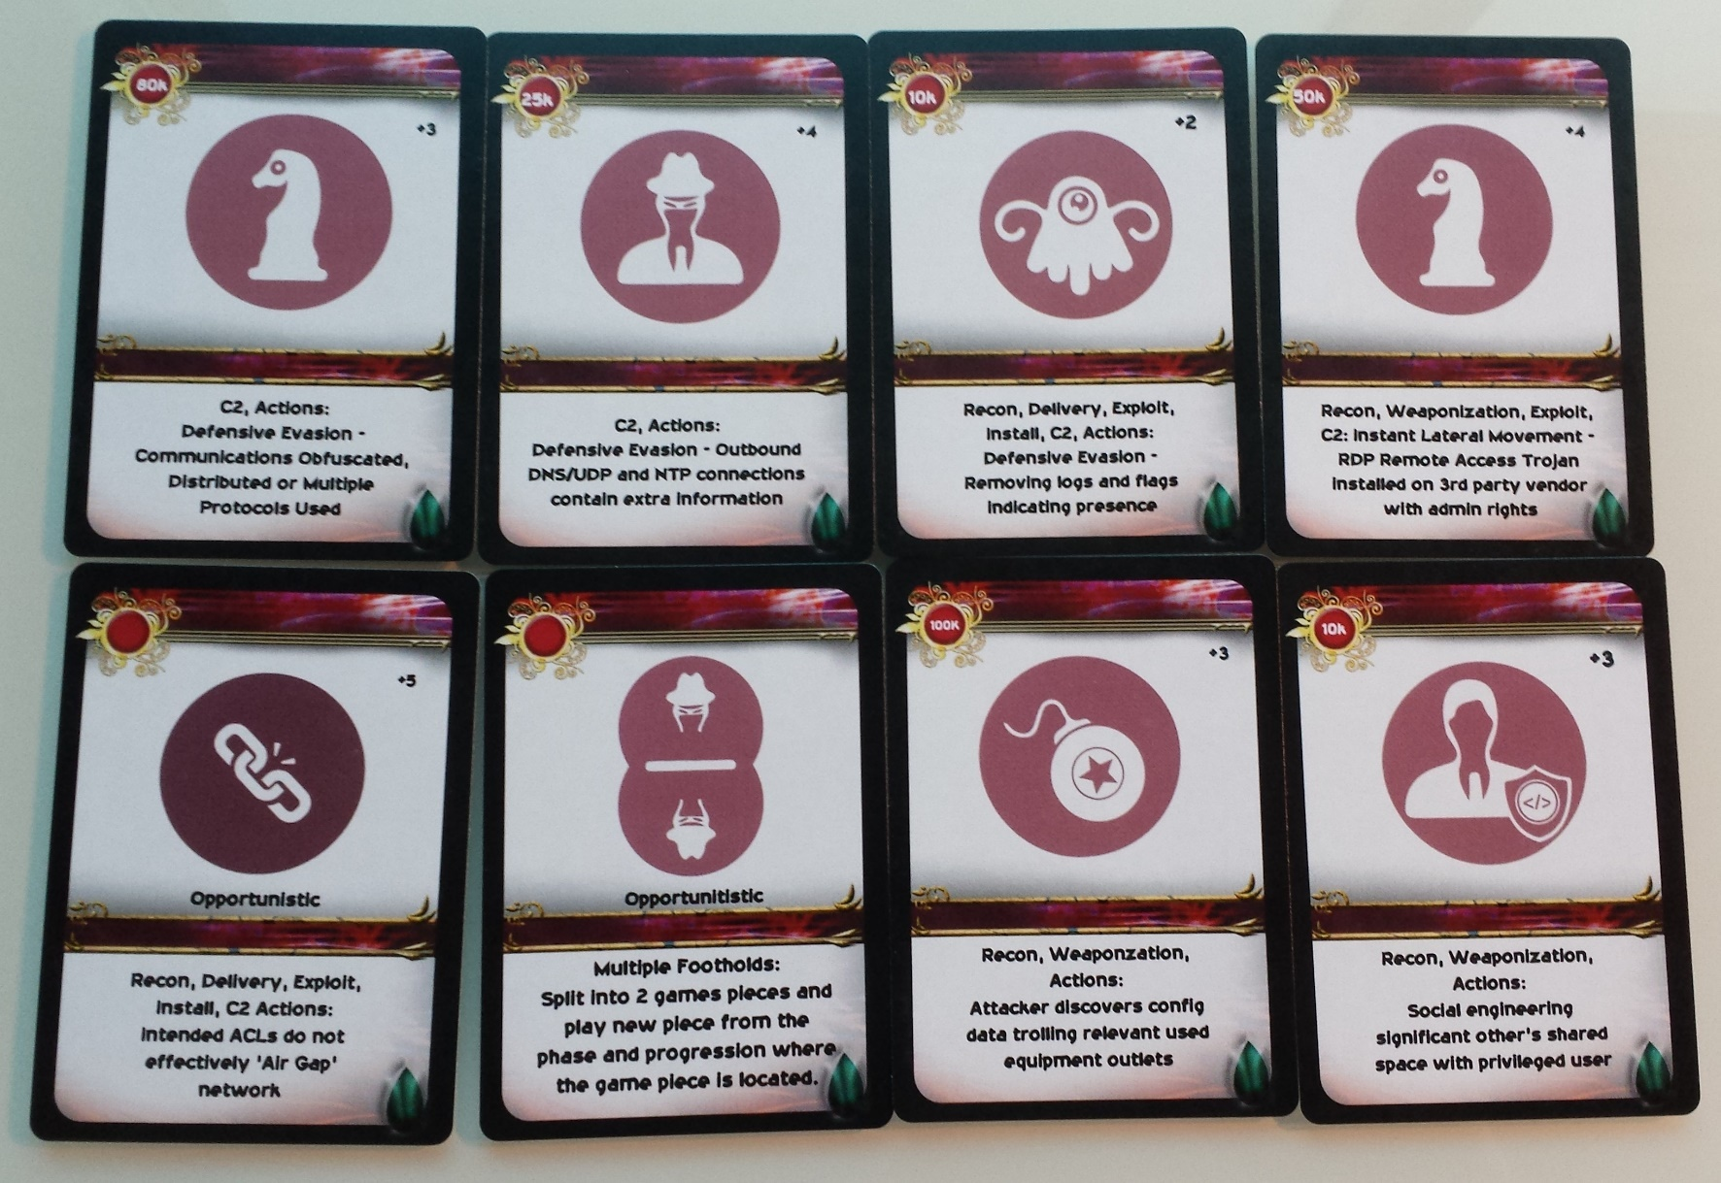
$ maelstrom – are you playing with a full deck?
60+ unique attacker cards

Slide 32
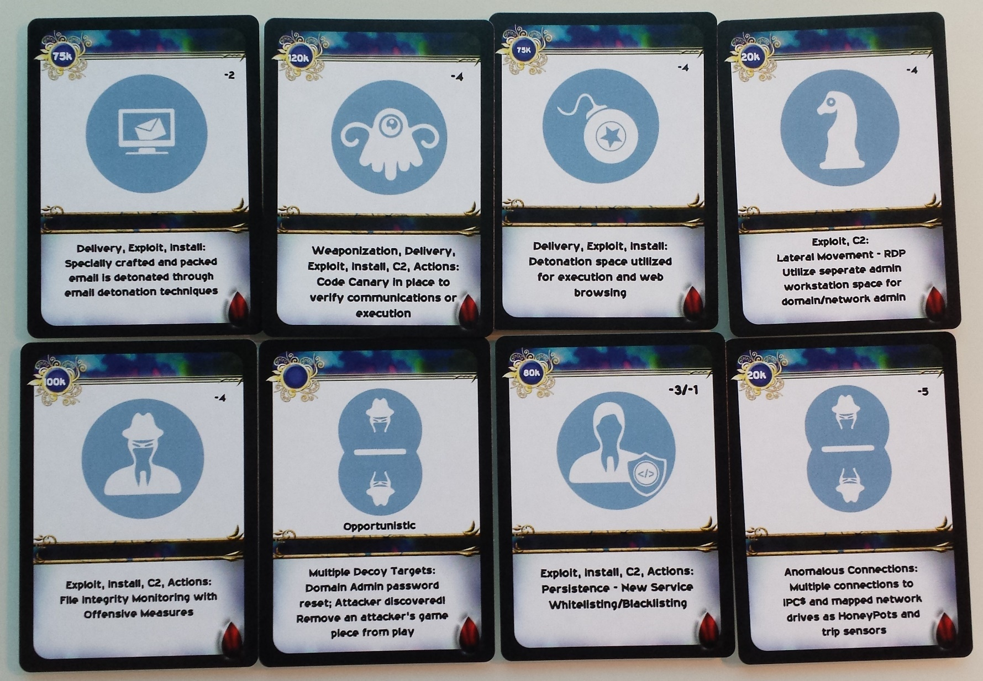
$ maelstrom – are you playing with a full deck?
70+ unique defender cards

Slide 33
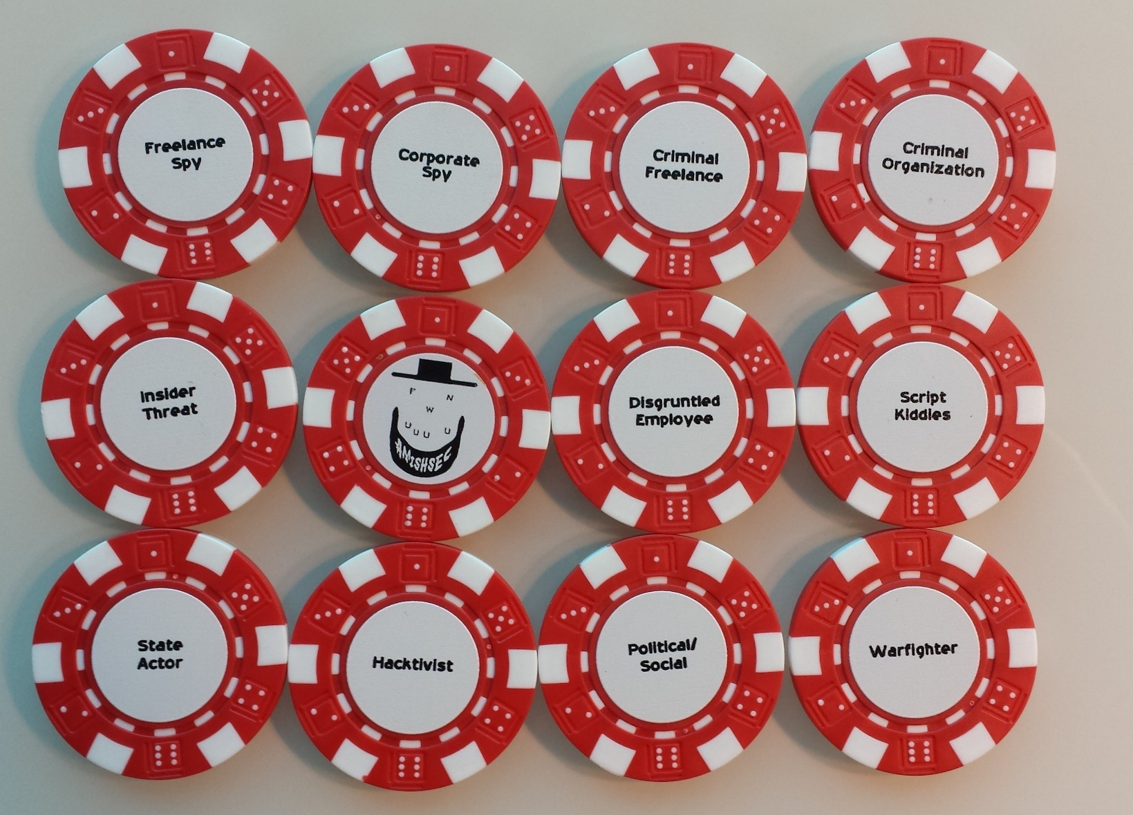
$ maelstrom – actor game pieces
12 unique threat actor chips – face down

Slide 34
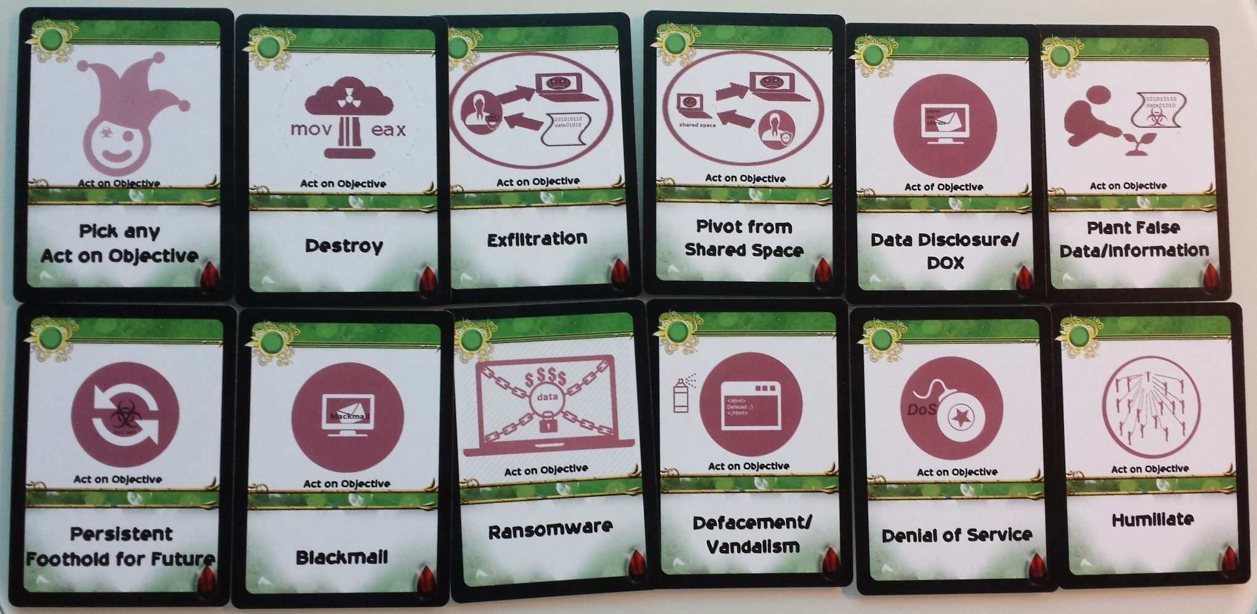
$ maelstrom – act on objective cards
11 unique act on objectives – face down in middle

Slide 35

$ maelstrom – methods of play
game board mockup – general rules
3 Versions – Easy, Tactical, Strategic
Dealt cards (easy), actively pick cards (tactical) or buy cards (strategic)
Choose number of attacker players
Attackers choose their Threat Actor
Attackers choose their Act on Objectives
Attackers seek to get to Act on Objectives through progression to win
Defenders prevent progression from Act on Objectives
Defender wins if sets the attacker pieces back to Delivery 3 times or Recon 2 times
Rules located here…
github.com/maelstromthegame/defcon24

Slide 36
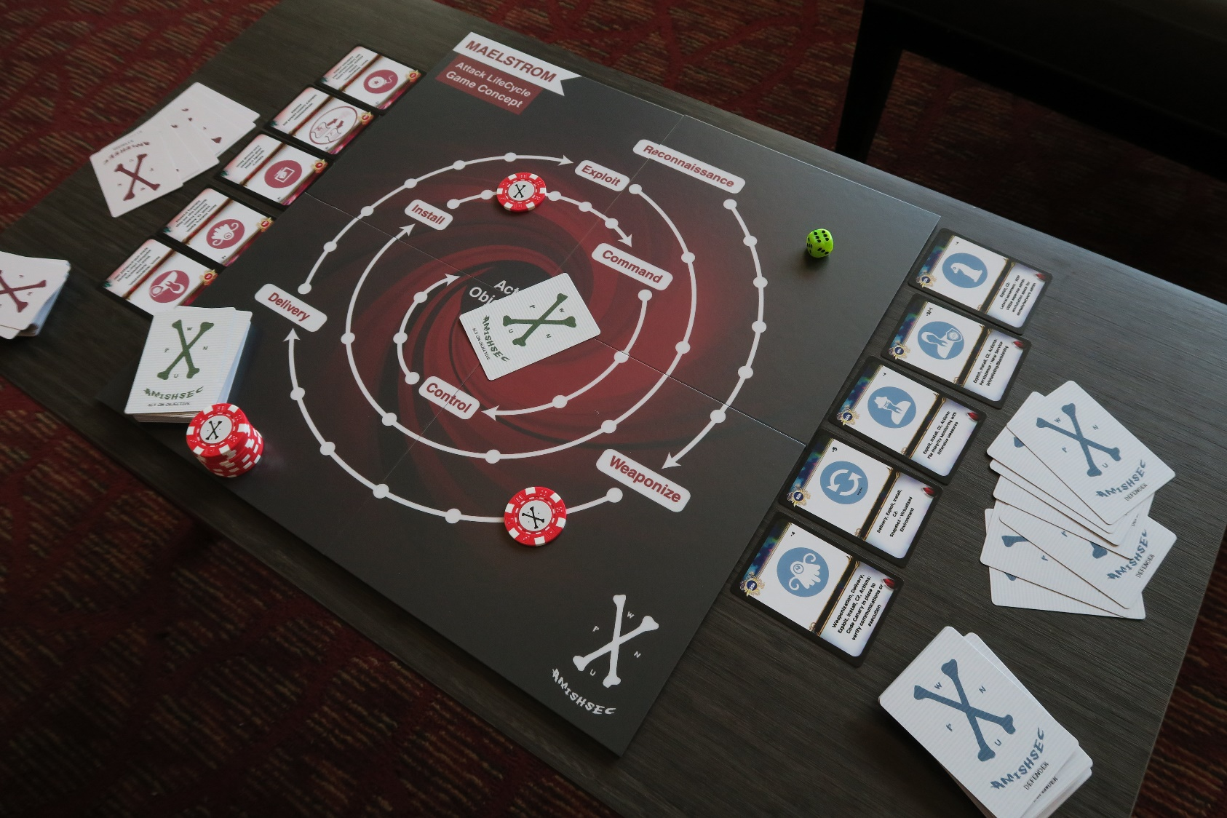
$ maelstrom – is it playable?
game board mockup – game play – yeah its playable!!!
sample video of game play - https://vimeo.com/177304576

Slide 37
$ maelstrom – are you playing with a full deck?
Use Cases
Education
Learn an attack lifecycle concept and make it part of a vocabulary
Build a security mindset in defenders who don’t do offense
Demonstration
Mini table top exercises
Defender practice - Investigator pattern recognition
Analysis and strategies for choosing technologies to win
Cost/Benefit analysis
Evangelism
Gamification as marketing
Helps to get the message to non security folks

Slide 38
$ build catalog of attack patterns – get more…
Rationalization
Progression steps in a 1-6 effectiveness – Picked 6 because of a dice
Cost rationalization based on a 1000 seat company
Prior Art
Hacker, Hacker II, Ctrl-Alt-Hack, Elevation of Privilege, Exploits, STIXITS, Game of PWNs, Breaches, Cyber Attribution Dice
No one has an Offensive and Defensive game play with a progressive board based on research

Slide 39
$ maelstrom – are you playing with a full deck?
Next Steps
Pursue
Submit work for upcoming CON talks, get input
Map to current attack patterns and developing patterns and play games
Played multiple rounds with investigators, red team members, engineers and others
Produce lessons from games
Digitizing and creating open source framework*** (wanna help?)
Expansion packs
Non-technical game development for kids (Spyder)
Let others play and update their decks, watch their decks and collect strategies ;)
LASTLY, digitize and let the ‘machine rise and play itself’…

Slide 40
$ where to get maelstrom stuff
Contribute, follow, volunteer, get the latest developments!
twitter.com/cybermaelstrom
github.com/maelstromthegame/defcon24
to print your copy of the game – coming very soon
cards, poker chips – watch twitter for vendor information (working on getting a sku with the vendor to print)
game board – download the file from github above and print at FedEx or through vendor
adding cards – use twitter above for peer review ;) and possible addition
watch twitter and github for digitized version (contact twitter to volunteer to help)

Slide 41
$ credits
MITRE - ATT&CK Framework
https://attack.mitre.org
MITRE - Cyber Resiliency Engineering Framework
https://www.mitre.org/capabilities/cybersecurity/resiliency
http://www2.mitre.org/public/industry-perspective/
Lockheed Martin – Cyber Kill Chain ®
http://www.lockheedmartin.com/content/dam/lockheed/data/corporate/documents/LM-White-Paper-Intel-Driven-Defense.pdf
Gerard Laygui
Garrett Adler
Collin Frietzsche
Brent Thibodo
Jerry Decime
Cale Smith
Tom Van Setten
George Mckee
Logan Browne
Darlene Leong
JR

Slide 42
$ questions?

Slide 43
$ backup slides if anyone goes there

Slide 44
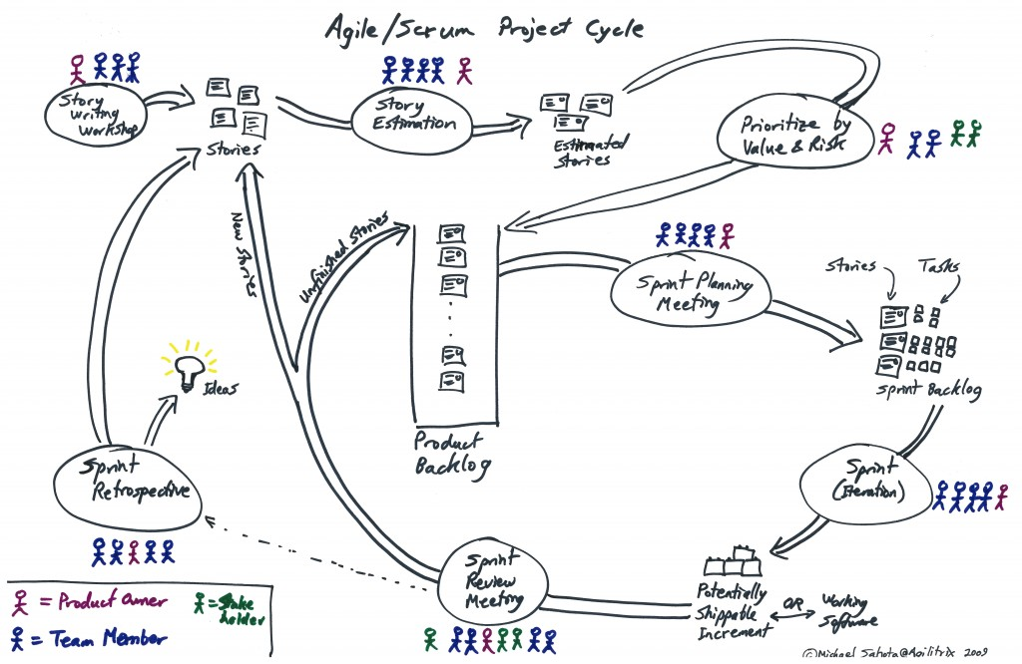
$ tortuosa concept – attacking attacker’s plan
…so agile you say

Slide 45
$ tortuosa concept – attacking attacker’s plan
Agile SCRUM Methodology
Stories:
Replays
Snapshots
Predecessors and Successors – feigning completion
Sprints :
Create resource unavailability – Maybe APT Team F uses AWS (during Team F stage block AWS)
Create resource contention – Flood targets?
Different teams using different tool sets
Build Project Backlog
Change Priorities
Cost: Increase Time and Backlog
https://en.wikipedia.org/wiki/Scrum_(software_development)

Slide 46
$ sources
[1] https://www.dhs.gov/what-security-and-resilience
[2] https://www.whitehouse.gov/the-press-office/2013/02/12/presidential-policy-directive-critical-infrastructure-security-and-resil
[3] http://www.whitehouse.gov/the-press-office/2013/02/12/executive-order-improving-critical-infrastructure-cybersecurity
[4] https://en.wikipedia.org/wiki/Cyber_Resilience
[5] https://www.mitre.org/publications/technical-papers/cyber-resiliency-engineering-framework
[6] https://www.mitre.org/sites/default/files/pdf/11_4436.pdf
[7] https://www.mitre.org/publications/technical-papers/cyber-resiliency-engineering-aid-the-updated-cyber-resiliency
[8] https://www.mitre.org/sites/default/files/publications/pr-15-1334-cyber-resiliency-engineering-aid-framework-update.pdf
[9] https://www.enisa.europa.eu/activities/Resilience-and-CIIP/national-cyber-security-strategies-ncsss/ScotlandNCSS.pdf
[10] https://www.axelos.com/best-practice-solutions/resilia
[11] https://blogs.microsoft.com/cybertrust/2016/02/11/working-to-increase-the-cyber-resilience-of-cities-around-the-globe/
[12] http://www2.mitre.org/public/industry-perspective/index.html
[13] http://www2.mitre.org/public/industry-perspective/guidance-executives.html
[14] http://www2.mitre.org/public/industry-perspective/guidance-architects.html
[15] http://www2.mitre.org/public/industry-perspective/slicksheets/disrupting_the_attack_surface.html
[16] http://csrc.nist.gov/publications/drafts/800-160/sp800_160_draft.pdf
[17] http://nvlpubs.nist.gov/nistpubs/SpecialPublications/NIST.SP.800-53r4.pdf
[18]http://www.lockheedmartin.com/content/dam/lockheed/data/corporate/documents/LM-White-Paper-Intel-Driven-Defense.pdf
[19] http://mena.boozallen.com/content/dam/MENA/PDF/resilience-in-the-cyber-era.pdf
[20] https://www.hexiscyber.com/news/hot-topics/pt-2-integration-automation-key-achieving-cyber-resilience

